Slide 1

GeneX
Genetics made practical

Slide 2












There are many parenting books and guidelines on the market
But typical parenting guides don’t fit every child.
Especially when a genetic condition is in the picture.
Notes:
Books comes one by one stash on top of each other, showing there are many books in the market . Then photos of kids with genetics conditions comes one by one and a red cross over the books showing they are not useful anymore.

Slide 3

For millions of families navigating genetic or developmental conditions
Guidance is fragmented
Routines are hard to follow
and support often feels out of reach.
Notes:
These icons and text come one by one from top to bottom

Slide 4

That’s why we built
GeneX – Genetics made Practical
A privacy-first app
That uses generative artificial intelligence
And based on where your child is
Builds a clear, daily, bite-sized activities
You can actually use it at home and at school

Slide 5
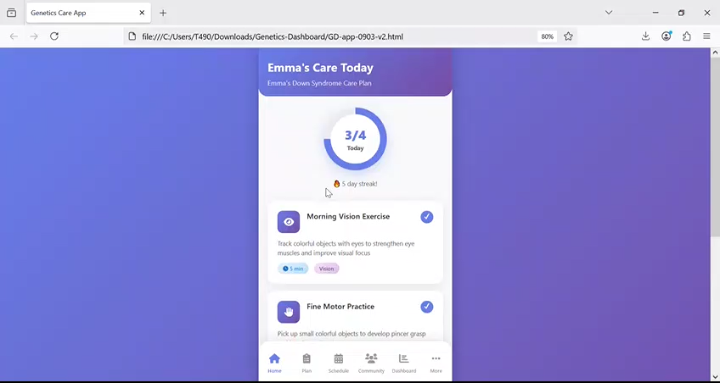
With curated:
5–10 minutes exercises
gentle reminders
progress tracking
community support
families gain confidence
schools stay aligned,
and children get consistent help - every day.

Slide 6
Together, we make care simpler, smarter, and supportive.
GeneX
Genetics Made Practical
Notes:
Genex logo will come up at the end

Slide 7
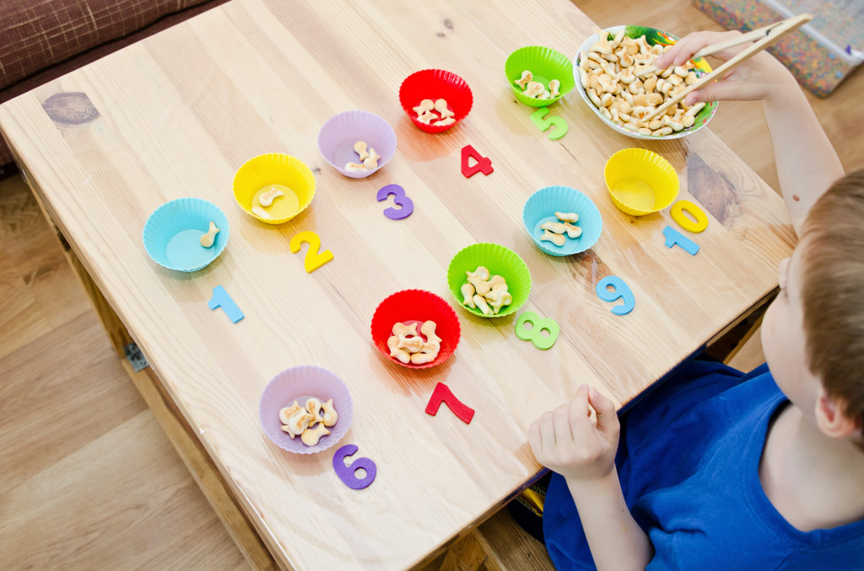

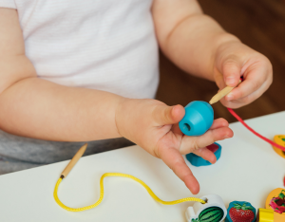
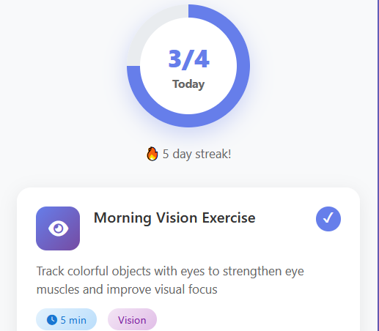


Notes:
With curated 5–10 minute exercises, reminders, progress tracking, and community support, families gain confidence, schools stay aligned, and children get consistent support — every day.

Slide 8





Notes:
"Together, we make care simpler, smarter, and supportive. GeneX — your genetics-aware care companion

